Slide 1

Topic 2: Exploratory Data Analysis

Slide 2
Course Overview
Topic | Description
Session 1
1 | Introduction to R and R Studio Cloud
2 | Exploratory Data Analysis: the tibble and ggplot2
3 | Functions, Vectors and Lists
4 | Introduction to Functionals with purrr
4 | Data Transformation I with dplyr
Session 2
6 | Data Transformation II with dplyr
7 | Statistical Transformation with ggplot2
8 | Advanced Functionals and Modelling with purrr
9 | Exploratory Data Analysis - Case Study using aimsir17

Slide 3
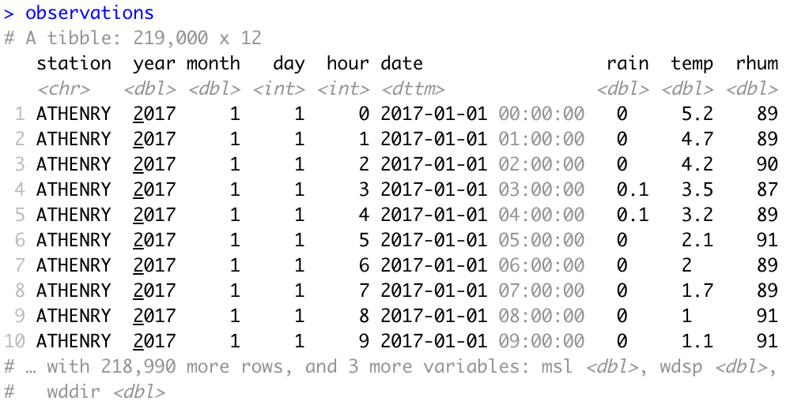
Data Frames/Tibbles
The most common way of storing data in R
A two-dimensional structure, with rows (observations) and columns (variables)

Slide 4
tibble abbreviations (variable types)
Abbreviation | Data Type
int | integers
dbl | doubles (real numbers)
chr | character vectors (strings
dttm | date-times
lgl | logical
fctr | factor (categorical variables with fixed possible values)
date | dates

Slide 5
Challenge 2.1
Explore some of the following tibbles in R
mpg (ggplot2)
flights (nycflights13)
observations (aimsir17)
eirgrid17 (aimsir17)
stations (aimsir17)

Slide 6
Exploratory Data Aanalysis: Goal
Develop an understanding of your data
Use questions as tools to guide your investigation
A creative process “the key to asking quality questions is to generate a large quantity of questions”
Useful to explore variation in variables

Slide 7
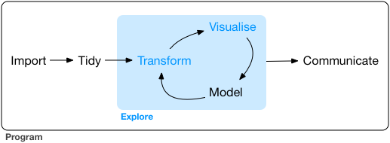
Data Exploration
“Data exploration is the art of looking at your data, rapidly generating hypotheses, quickly testing them, then repeating again and again and again.” (Wickham and Grolemund 2017).

Slide 8
Defining Important Terms (Wickham and Grolemund)
Term | Explanation
Variable | A quantity, quality or property that you can measure
Value | The state of a variable when you measure it. The value of a variable may change from measurement to measurement
Observation (or case) | A set of measurements made under similar conditions (you usually make all of the measurements in an observation at the same time and on the same object). An observation will contain several values, each associated with a different variable.
Tabular data | A set of values, each associated with a variable and an observation. Tabular data is tidy if each value is placed in its own “cell”, each variable in its own column, and each observation in its own row. All the data in aimsir17 and ggplot2 is tidy data.

Slide 9
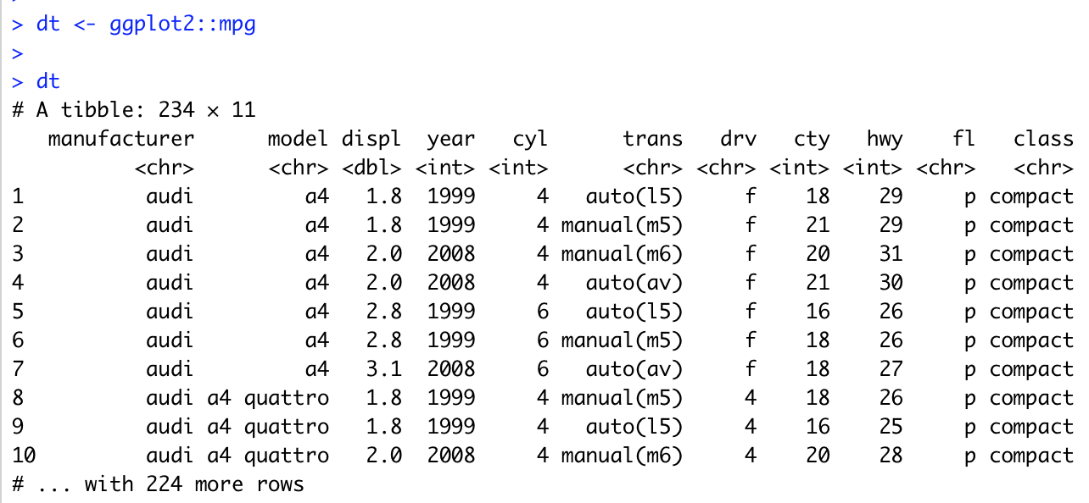
Data Visualisation with ggplot2
“The simple graph has brought more information to the data analyst’s mind that any other device.” – John Tukey

Slide 10
Fuel Economy Data Set (ggplot2::mpg)
This dataset contains a subset of the fuel economy data that the EPA makes available on http://fueleconomy.gov. It contains only models which had a new release every year between 1999 and 2008 - this was used as a proxy for the popularity of the car.
manufacturer | manufacturer | drv | f = front-wheel drive, r = rear wheel drive, 4 = 4wd
model | model name | cty | city miles per gallon
displ | engine displacement, in litres | hwy | highway miles per gallon
year | year of manufacture | fl | fuel type
cyl | number of cylinders | class | “type” of car
trans | type of transmission

Slide 11
First Steps
Generate a first graph to help answer the following question:
Do cars with big engines use more fuel than cars with small engines
What might the relationship between engine size and fuel efficiency look like?
Positive or negative?
Linear or non-linear?

Slide 12
Selecting data
Among the variables are:
displ, a car’s engine size in litres
hwy, a car’s fuel efficiency on the highway in miles per gallon

Slide 13
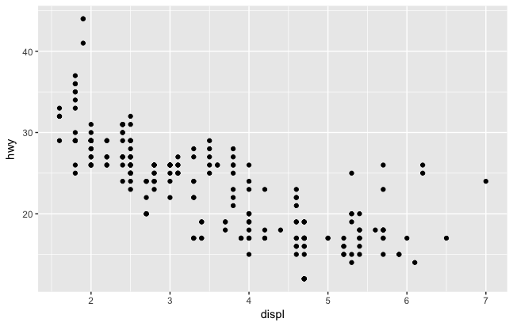
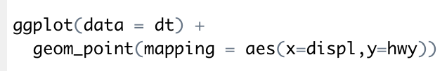
Creating a ggplot

Slide 14
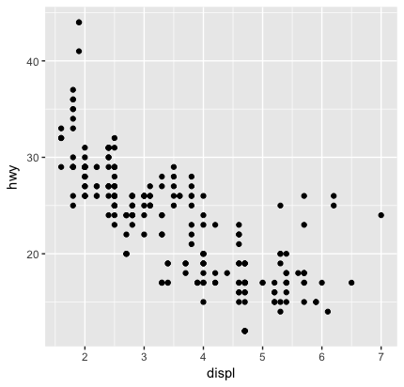
Interpreting the plot
The plot shows a negative relationship between engine size (displ) and fuel efficiency (hwy)
Cars with big engines use more fuel
Does this confirm or refute your hypothesis about fuel efficiency and engine size?

Slide 15
Challenge 2.2
What might the relationship between engine size and fuel efficiency (city mpg) look like?

Slide 16
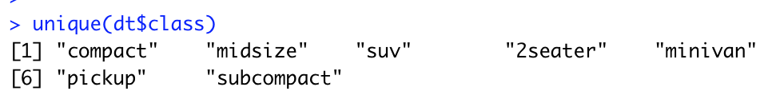
(2) Aesthetic Mappings
“The greatest value of a picture is when it forces us to notice what we never expected to see” – John Tukey
A third variable can be added to a 2-D plot by mapping it to an aesthetic.
An aesthetic is a visual property of the plot’s objects.
An aesthetic’s level could be colour, size or shape.

Slide 17
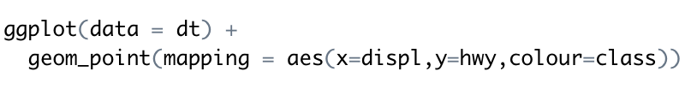
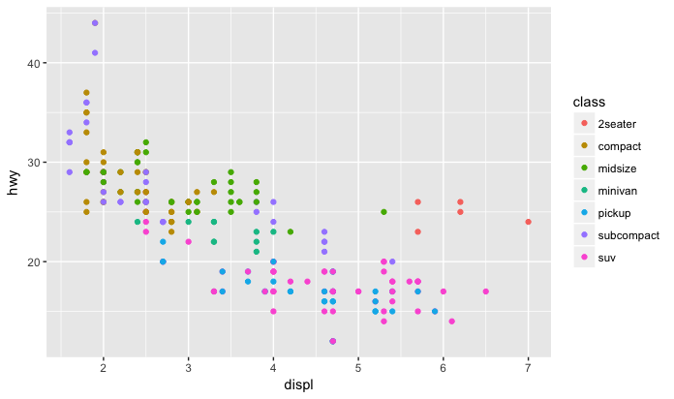

Slide 19
Challenge 2.3
Generate the following graph from aimsir17 (January)

Slide 20
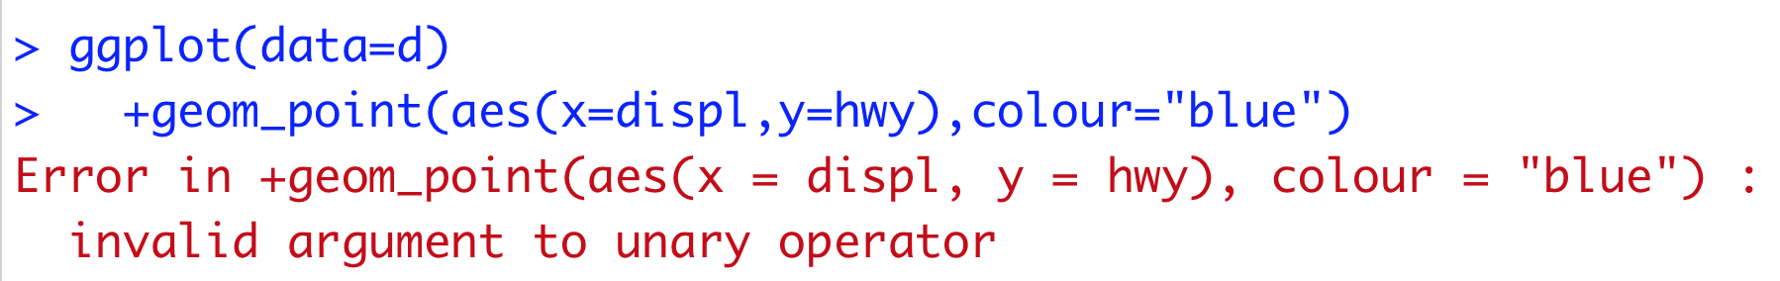
(3) Common Problems
R can be “extremely picky, and a misplaced character can make all the difference”
Make sure every ( is matched with a )
For ggplot calls, the + must come at the end of the line, not at the start (see below)
You can get help about any function by running ?function_name

Slide 21
(4) Facets
Another way to add categorical variables is to split a plot into facets, subplots that display one subset of the data.
To facet your plot by a single variable, use facet_wrap(), with ~ followed by the variable name
To facet on the combination of two variables, used facet_grid()

Slide 22
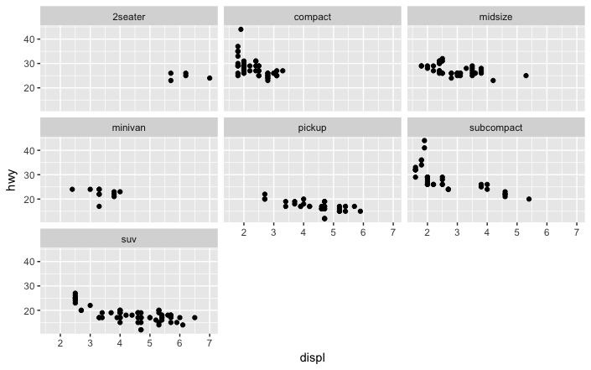

Slide 23
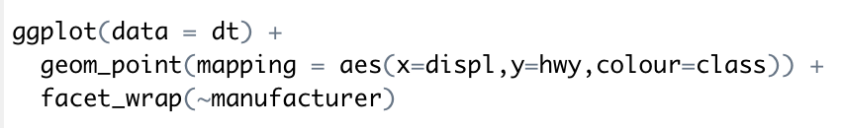
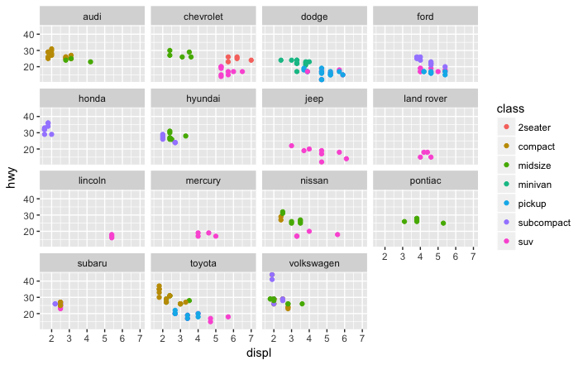

Slide 24
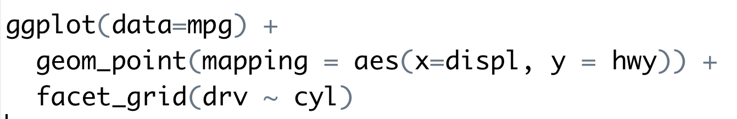
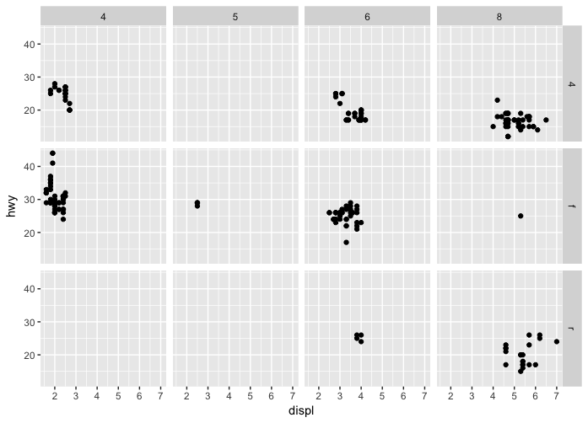

Slide 25
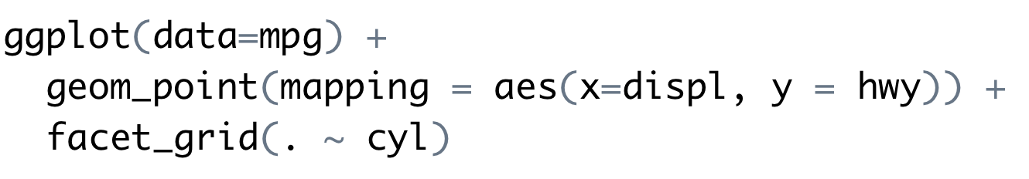
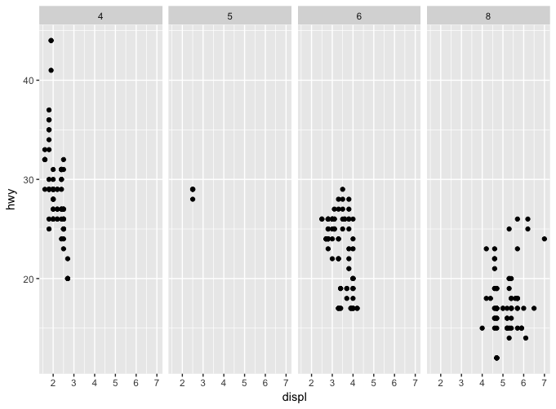

Slide 26
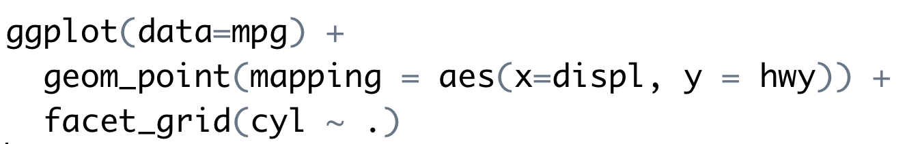
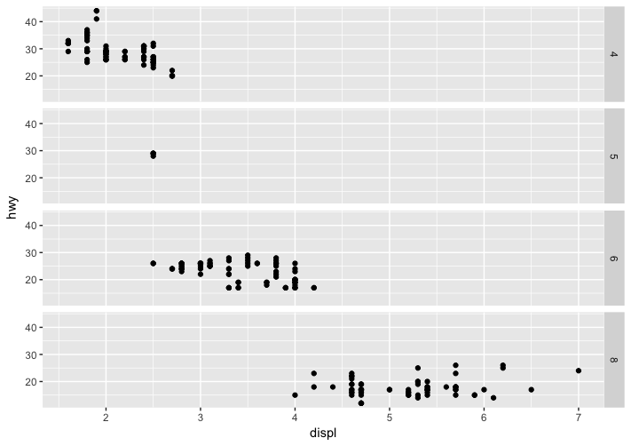

Slide 27
Challenge 2.4
Use facet_wrap to generate this for every weather station as a separate plot

Slide 28
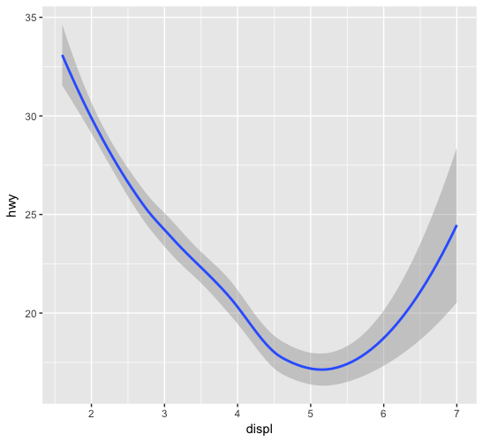
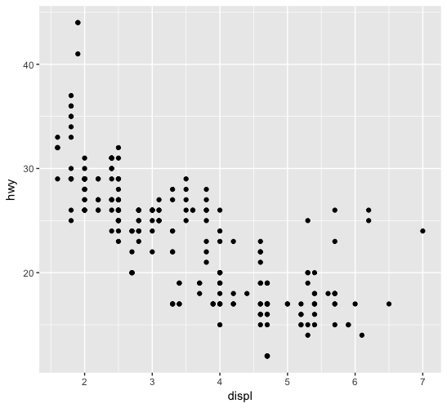
(5) Geometric Objects
Both of these plots contain the same x and y variable, and describe the same data
The plots are not identical, they use a different visual object to represent the data
In ggplot2 syntax, we say the use different geoms

Slide 29
geom
A geom is a geometrical object that a plot uses to represent data
Bar charts use bar geoms, line charts use line geoms, and scatter plots use the point geom.
To change the geom in your plot, simply change the geom function that is added to the ggplot call.

Slide 30
Sample plot geoms
Geom | Purpose
geom_smooth() | Fits a smoother to data and displays the smooth and its standard error
geom_boxplot() | Produces a box-and-whisker plot to summarise the distribution of a set of points
geom_histogram() geom_freqpoly() | Shows the distribution of continuous variables
geom_bar() | Shows the distribution of categorical variables
geom_path() geom_line() | Draws lines between data points
geom_area() | Draws an area plot, which is a line plot filled to the y-axis. Multiple groups will be stacked upon each other
geom_rect() geom_tile() geom_raster() | Draw rectangles
geom_polygon() | Draws polygons, which are filled paths.

Slide 31
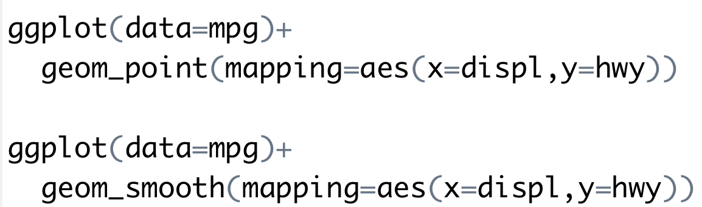
Examples of using different geoms

Slide 32
Challenge 2.5
Combine both these onto a single plot

Slide 33
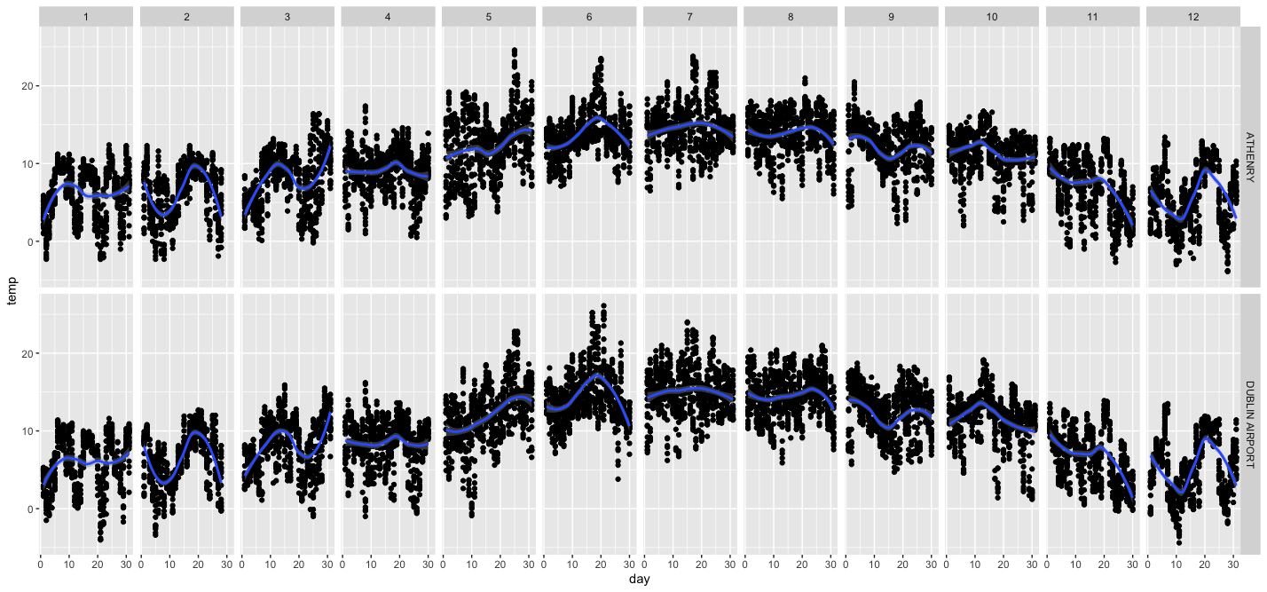
Challenge 2.4
Generate the following graph from aimsir17. Focus on Athenry and Dublin Airport

